Slide 1




Dayananda Sagar University (DSU) - Main Campus
School of Engineering
Devarakaggalahalli, Harohalli Kanakapura Road, Bengaluru South Dist., Karnataka 562112
DEPARTMENT OF
COMPUTER SCIENCE AND ENGINEERING
(ARTIFICIAL INTELLIGENCE AND MACHINE LEARNING)
Capstone Project Phase-II (22AM4801)
Review-I
Title: “Multi-Stage Deep Learning Based CCTV Crime Detection System”
Under the Supervision of
Prof. Sriramkumar R
Assistant Professor
Department of CSE (AI&ML)
SOE, DSU.
Amar H M ENG23AM1001
Sanjay S ENG23AM1004
Deepak Mahto ENG22AM0087
Shashanka N ENG23AM1006
Academic Year: 2025-2026

Slide 2
Contents
Conference Paper Details
Phase 1 Review 3 Comments
Problem Statement
Objectives
Source of Data Collection
Methodology / Approach
Expected Outcomes
Timeline (Gantt Chart)
References
Code
Team Member Contributions

Slide 3
Confernce Name and Acceptance Notification
Conference Name: International conference on robotics ML AI (ICRMLAI) South Asia Research Center(SARC)
Status – Yet to Apply
Mail Acceptance: Pending
Paper Presentation Date: 27 march 2026, Mysore India

Slide 4
Phase I Review 3 Comments addressed
Suggestion 1 - Use multiple models for better activity understanding
Solution: A multi-stage deep learning framework is implemented where different models perform specific tasks. Motion detection filters inactive frames, MobileNetV2 detects abnormal behavior, ResNet18 identifies fight activity, and R3D-18 performs temporal crime analysis. Using multiple models improves accuracy and reduces false alarms by dividing the problem into smaller tasks.
Suggestion 2 - Use large and diverse datasets for better validation
Solution: Multiple public datasets such as RWF-2000 and UCF-Crime are used, containing videos of different lengths, qualities, and crime categories. This helps the system learn from varied real-world scenarios and improves model generalization across different environments and camera conditions.

Slide 5
Problem Statement
Gap / Challenges Being Addressed
CCTV cameras require continuous human monitoring.
Human operators may miss important incidents due to fatigue.
Traditional motion detection gives many false alarms.
Existing systems cannot understand human activities or crime situations.
Difficulty in analyzing long video streams in real time.
Clear Problem Definition
Need for an intelligent system to automatically analyze CCTV video.
System should distinguish normal activity from suspicious or criminal activity.
System should generate real-time alerts to assist security monitoring.

Slide 6
Objectives
Achieved Objectives
Implemented motion-based filtering to select active video segments.
Developed abnormal activity detection using a deep learning model.
Implemented fight detection using video-based learning.
Integrated multi-stage pipeline for crime detection from live video.
Remaining Objectives to be Achieved
Improve accuracy using larger and more diverse datasets.
Optimize system performance for real-time deployment on edge devices.
Add advanced event-level decision logic to reduce false alerts.
Extend system to support multiple camera inputs simultaneously.

Slide 7
Mention Base Paper and Novelty of your Proposed Work
Paper Title | Algorithm | Dataset | Metrics | Research Gap
Real-World Anomaly Detection in Surveillance Videos | CNN + Temporal Learning | UCF-Crime | AUC = 75.41% | Single-stage anomaly detection leads to false alarms; proposed work uses multi-stage filtering and real-time pipeline

Slide 8
Source of Data Collection
Data Collection
Data collected from publicly available CCTV and action recognition datasets used for research purposes.
Video data includes both normal activities and crime-related activities.
Number of Instances & Classes
RWF-2000 Dataset
Classes: Fight, Non-Fight
Instances: 2000 video clips
UCF-Crime Dataset
Classes: Normal and Multiple Crime Categories
Instances: Large-scale untrimmed surveillance videos covering different crime scenarios

Slide 9
Data Characteristics
The data used contains videos of different lengths depending on the activity duration.
Video quality varies due to different CCTV environments and recording conditions.
The quantity of data differs across datasets based on model requirements.
Short video clips are used for fight detection, while longer videos are used for temporal crime analysis.
This variation helps the models learn real-world surveillance conditions and improves system robustness.

Slide 10
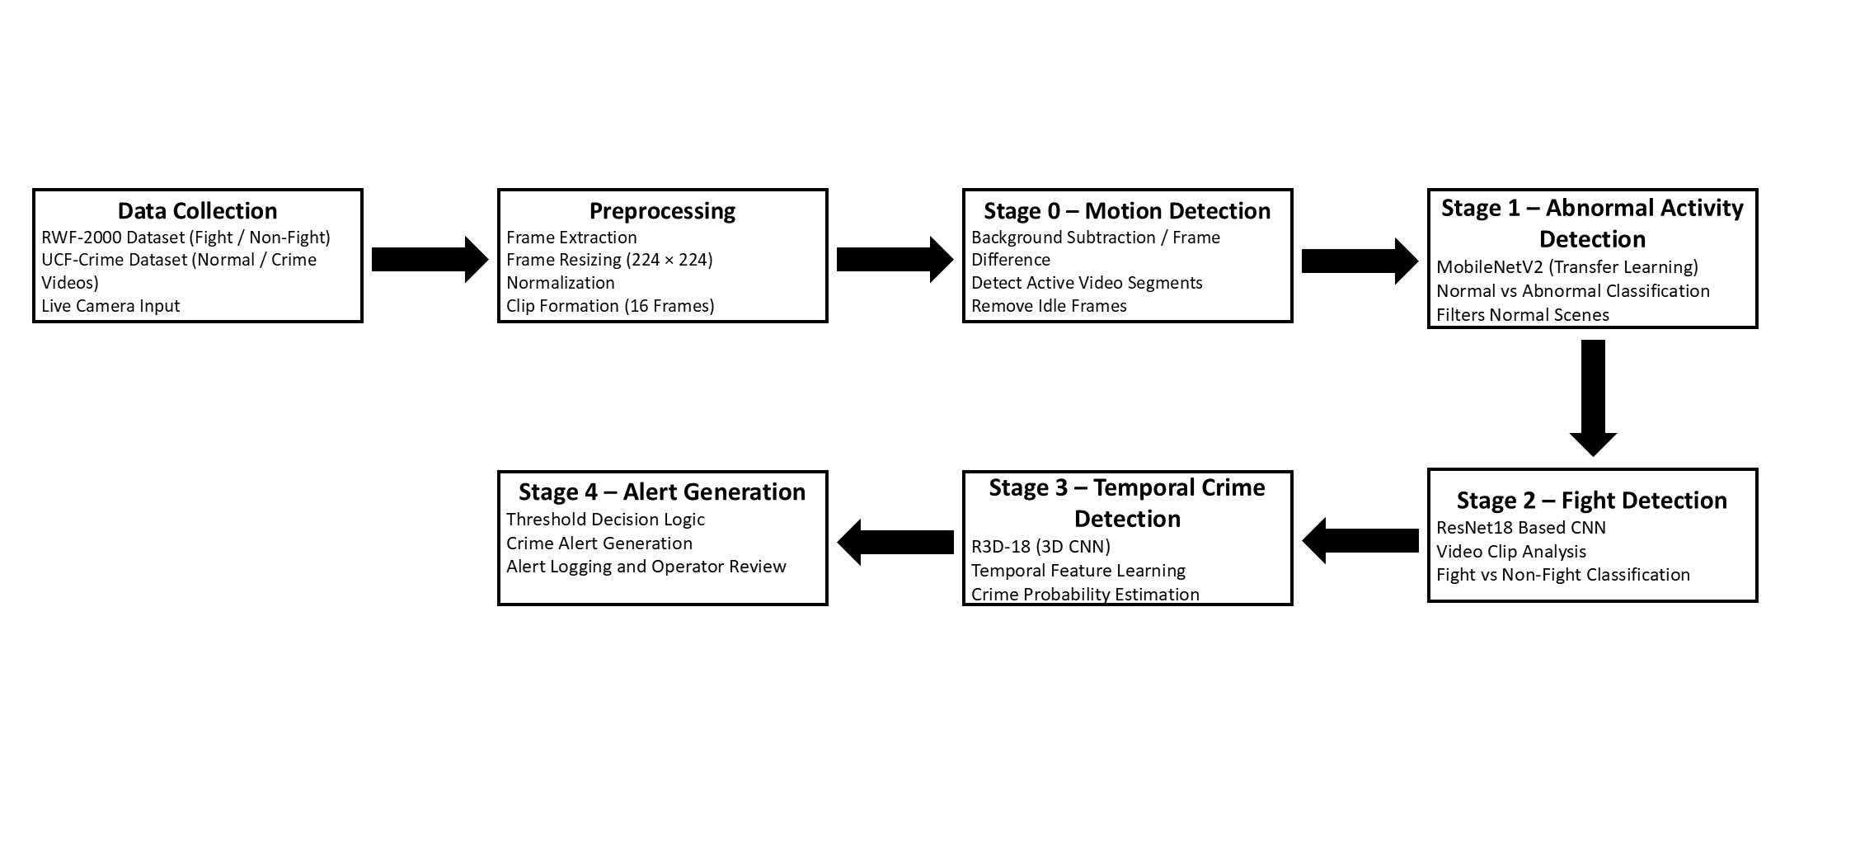
Methodology / Proposed Framework Architecture

Slide 11
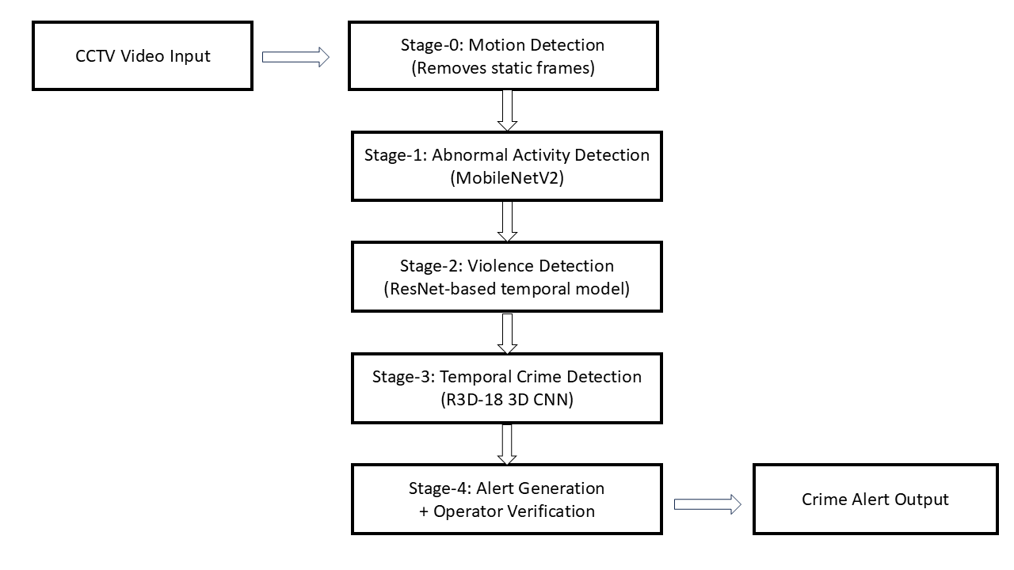
Methodology / Architecture of Proposed Hybrid Technique

Slide 12
Graphical Results on Multiple and Real Time Dataset

Slide 13
Expected Outcomes
Outcome 1
Integration of all stages into a complete end-to-end CCTV crime detection system with real-time video input.
Outcome 2
Improvement of detection accuracy and reduction of false alerts using temporal analysis and multi-stage model validation.
Outcome 3
Development of alert generation and monitoring interface for operator review and event logging.
Outcome 4
Optimization of system performance for stable real-time execution on limited hardware resources.
Outcome 5
Evaluation of the proposed system on multiple datasets to validate robustness across different surveillance environments.

Slide 14
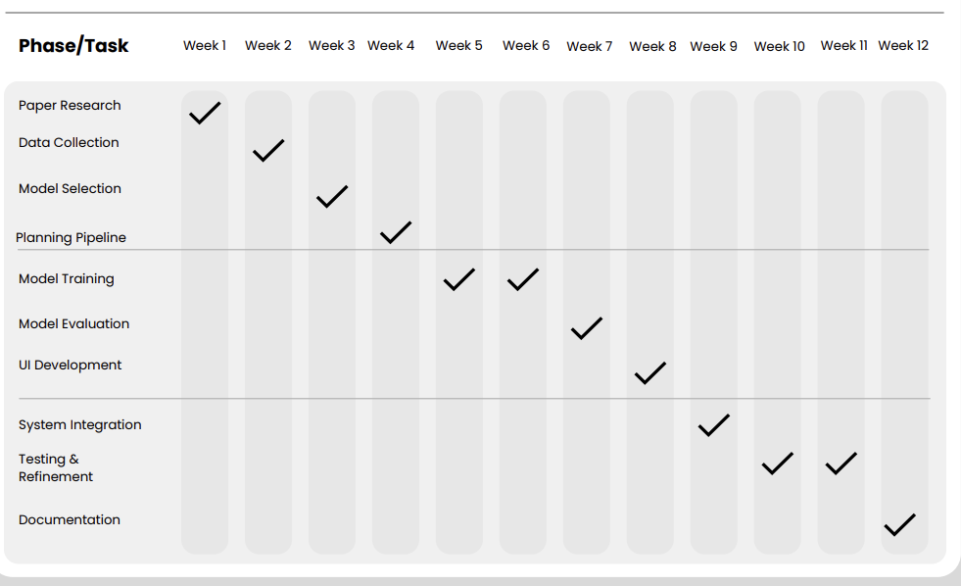
Timeline (Gantt Chart)

Slide 15
References
[1] W. Sultani, C. Chen, and M. Shah, “Real-World Anomaly Detection in Surveillance Videos,” in Proceedings of the IEEE Conference on Computer Vision and Pattern Recognition (CVPR), 2018.
[2] M. Cheng, K. Cai, and M. Li, “RWF-2000: An Open Large Scale Video Database for Violence Detection,” arXiv preprint arXiv:1911.05913, 2019.
[3] T. Hassner, Y. Itcher, and O. Kliper-Gross, “Violent Flows: Real-Time Detection of Violent Crowd Behavior,” in IEEE CVPR Workshops, 2012.
[4] J. Carreira and A. Zisserman, “Quo Vadis, Action Recognition? A New Model and the Kinetics Dataset,” in IEEE CVPR, 2017.
[5] D. Tran et al., “Learning Spatiotemporal Features with 3D Convolutional Networks,” in IEEE ICCV, 2015.
[6] K. Simonyan and A. Zisserman, “Two-Stream Convolutional Networks for Action Recognition in Videos,” in Advances in Neural Information Processing Systems (NeurIPS), 2014.
[7] M. Bianculli et al., “A Dataset for Automatic Violence Detection in Videos,” Data in Brief, 2020.
[8] H. Baca et al., “Efficient Human Violence Recognition for Surveillance Systems,” 2024.
[9] P. Zhang et al., “Research on Anomaly Detection of Surveillance Video Based on Deep Learning,” 2023

Slide 16
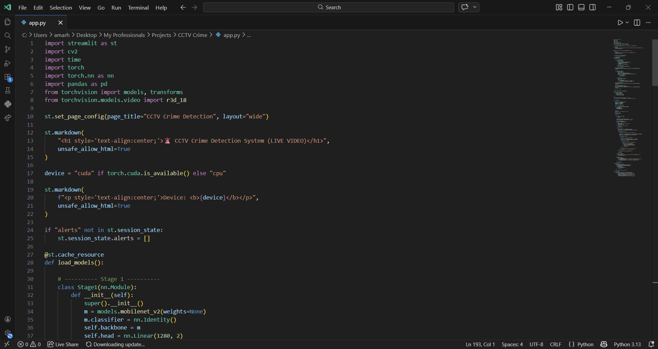
Code

Slide 17
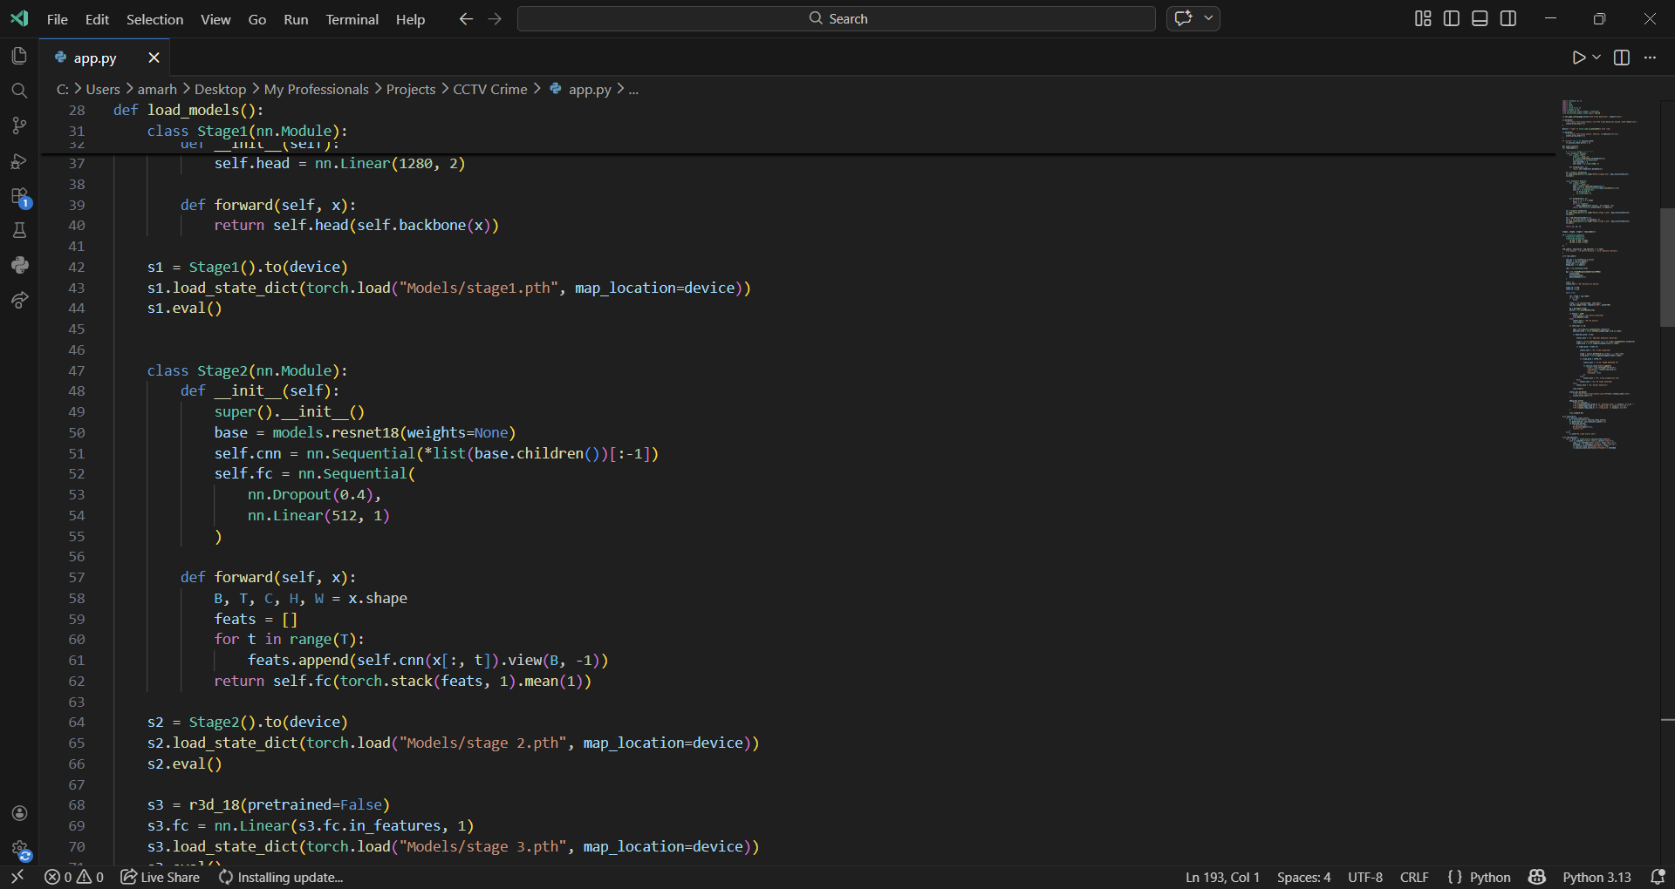

Slide 18
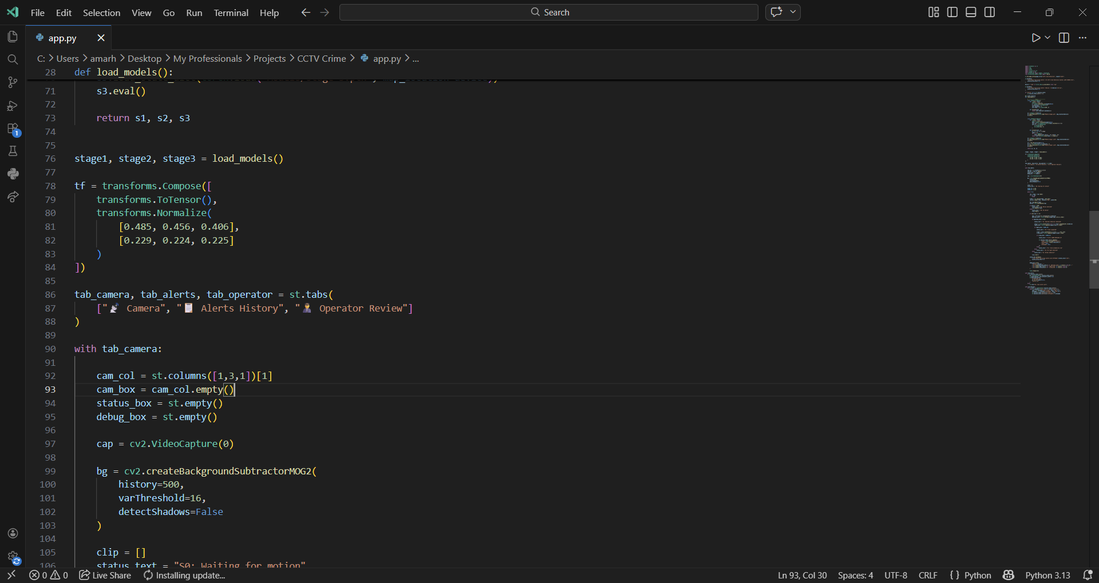

Slide 19
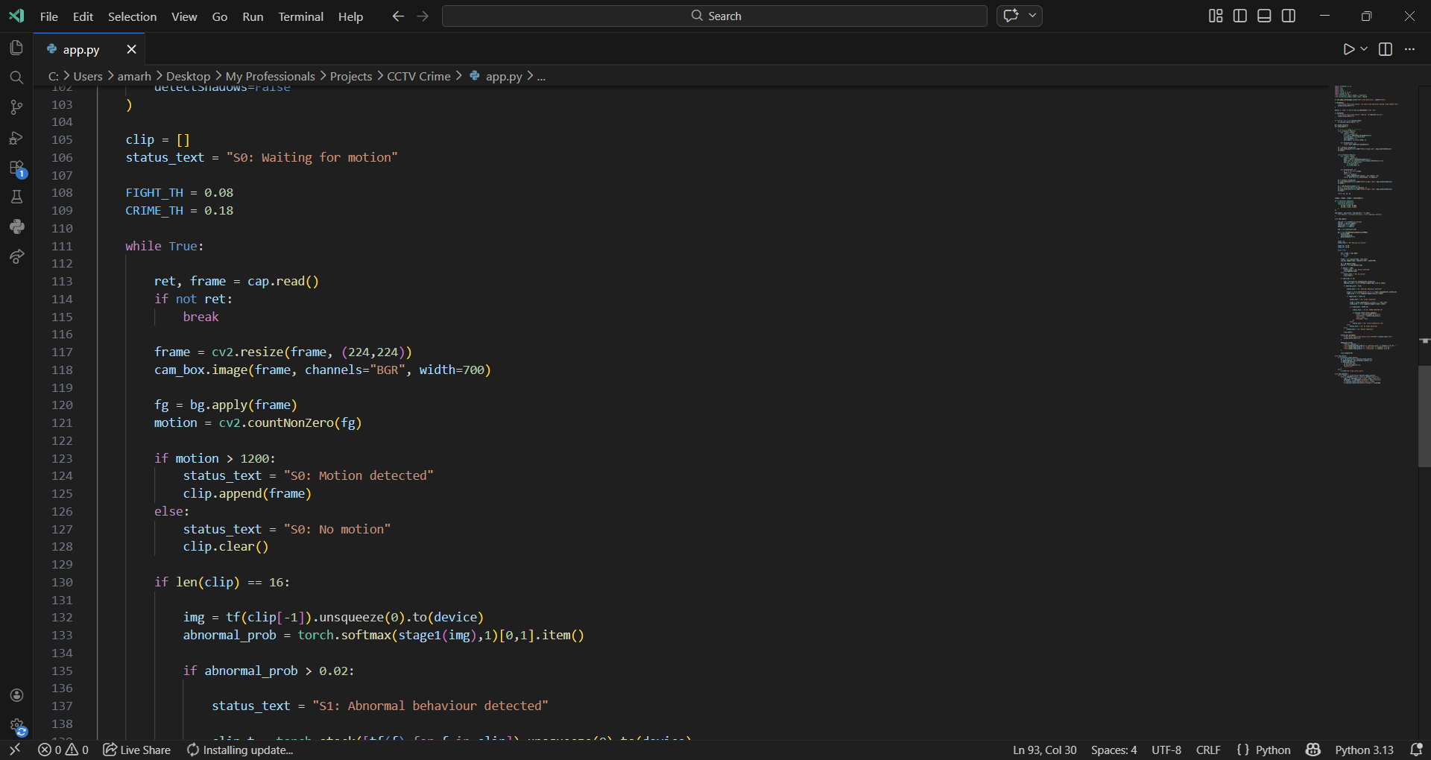

Slide 20
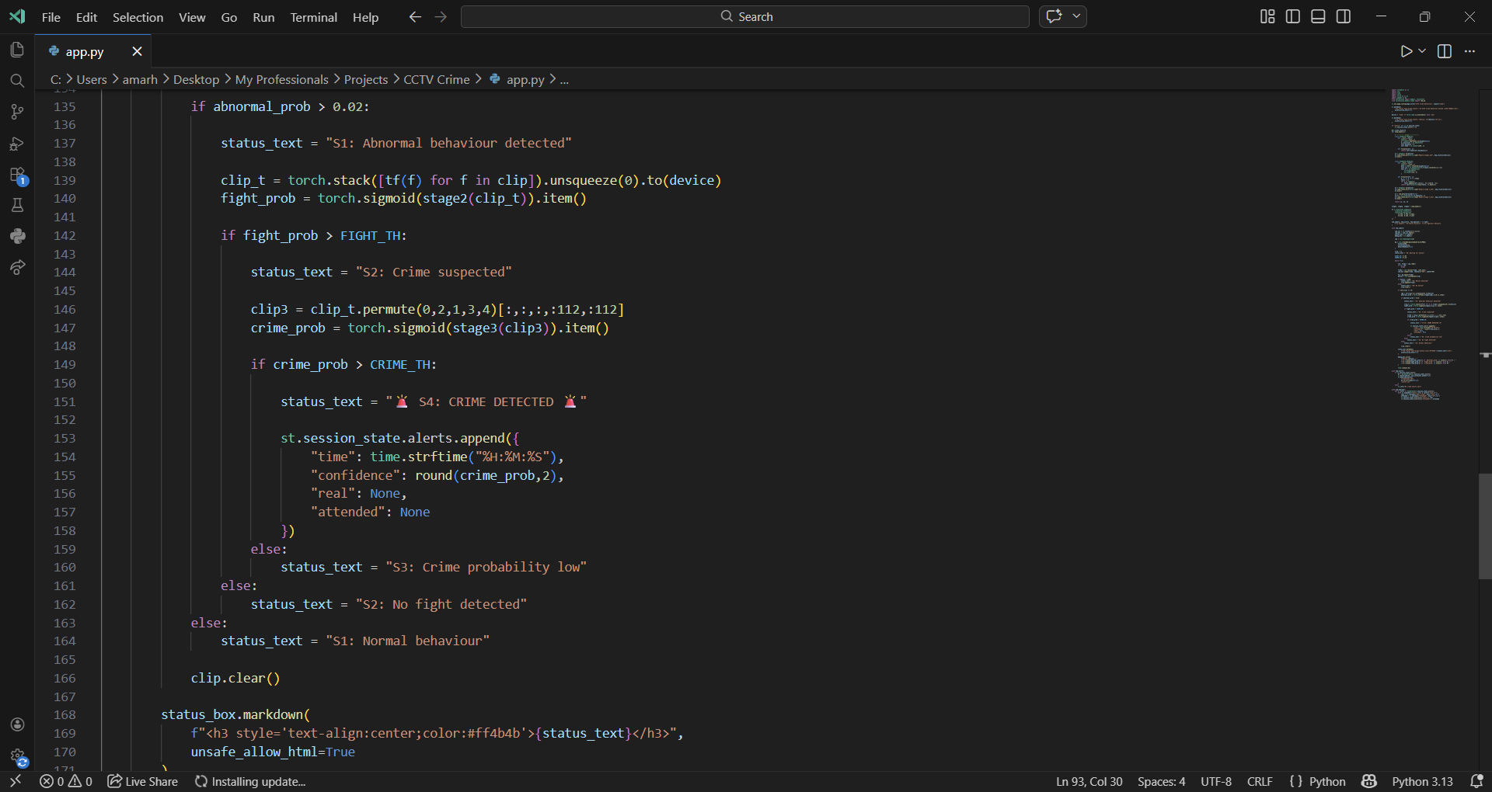

Slide 21
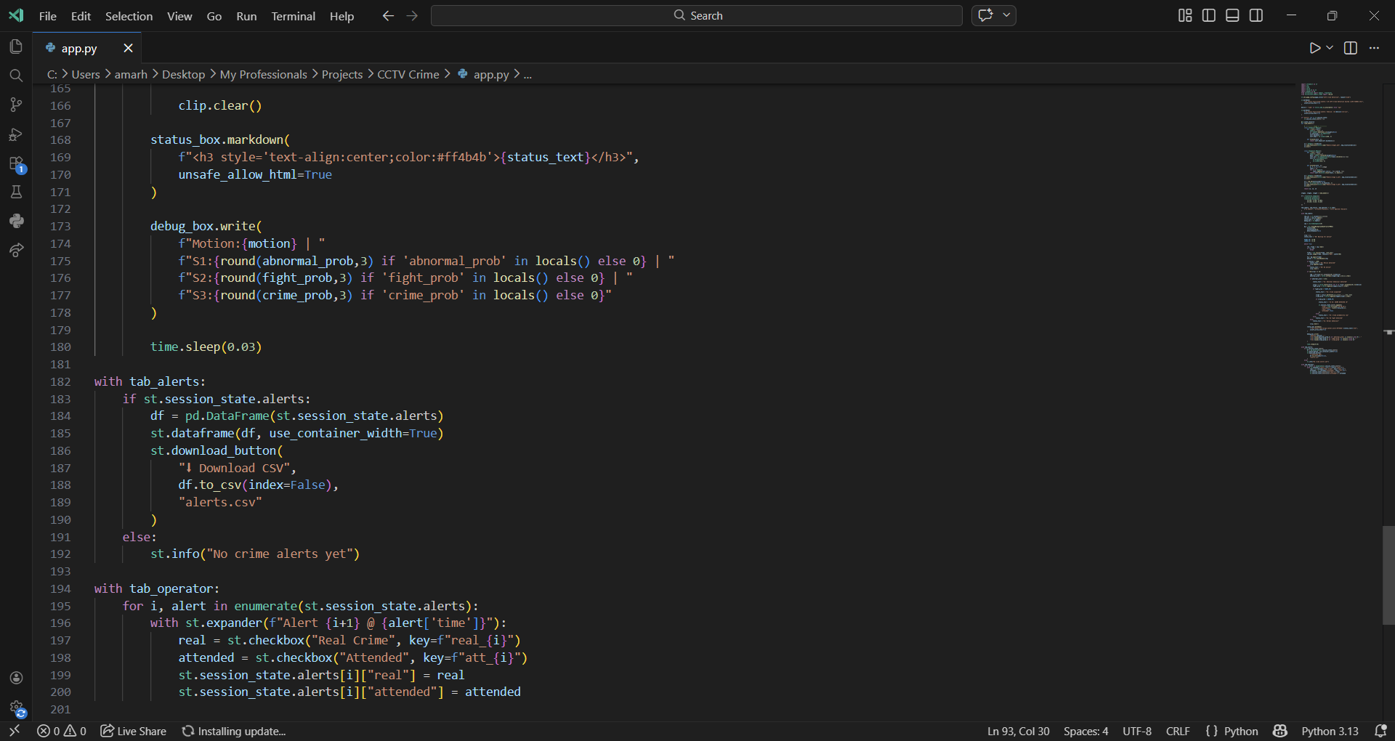

Slide 22
Contribution of Team Member
Amar H M: Model Training , Model Evaluations and Article
Sanjay S: Planning Pipeline , UI and Report
Deepak Mahto: Datasets Collection , Data Cleaning and PPT
Shashanka N: Searching of Article and checking Plagiarisms

Slide 23


